Slide 1

Beating the Market with AI
Presented by :
Jason , Majid, Justin, Ragini , Souk

Slide 2

Project Approach
UseD trading algorithms and AI to identify the best model for trading.
Libraries: Pandas, matplotlib, NumPy, TA lib, scikit-learn
Pandas

Slide 3

Scope and Purpose
To identify the best feature sets and model real-world usage in finance.
Multiple machine learning models spanning two stocks were analyzed.
The project's objective is to determine whether model can train and perform tests on one stock while maintaining performance when tested on a different stock.

Slide 4

Strategies Used for testing
Triple EMA crossover strategy,
RSI,
MACD indicators, single 7-Day EMA

Slide 5
Models Explored
Three Models explored
Logistic Regression
Linear Discriminant Analysis
MLP Classifier

Slide 6

Sources for Data Collection
Using Yahoo Finance, stock data were extracted from CSV files.

Slide 7

Demonstrations

Slide 8
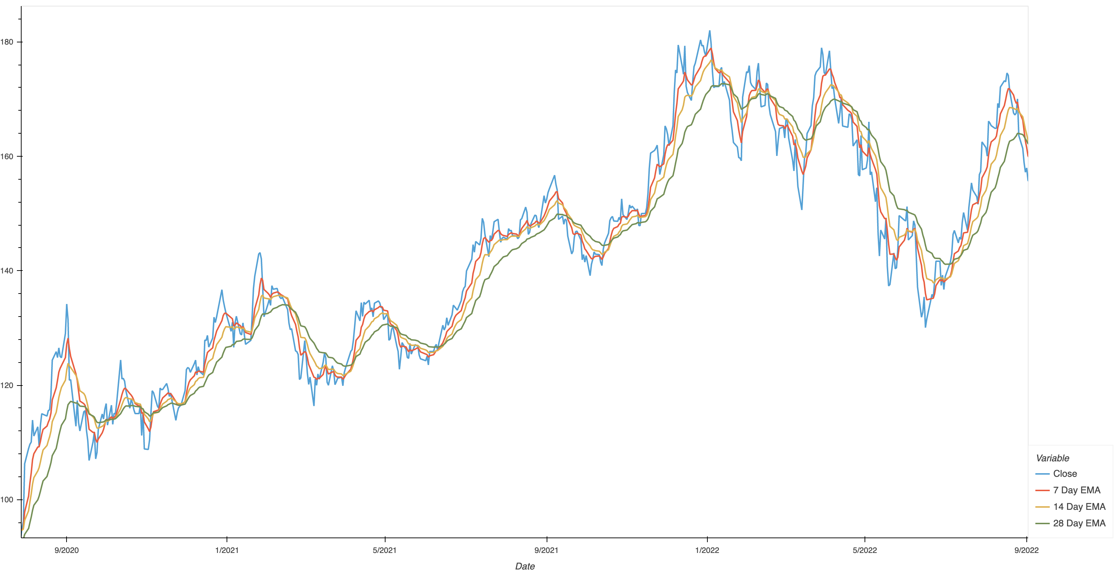
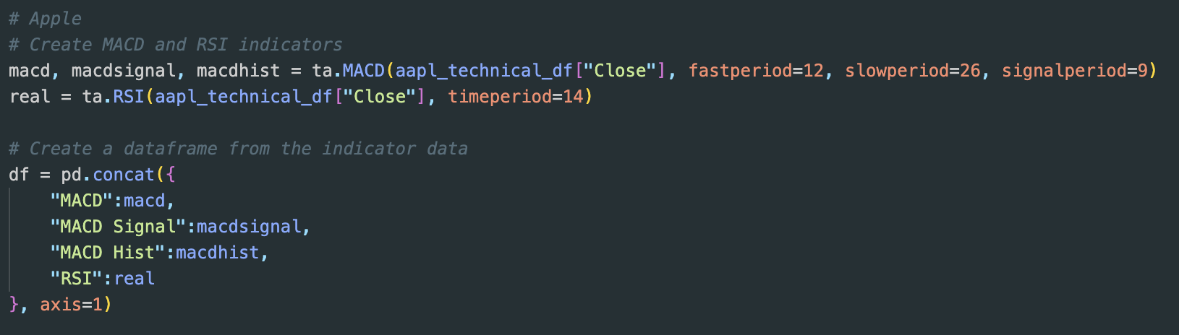
Techniques Used
Note: Temp Image

Slide 9
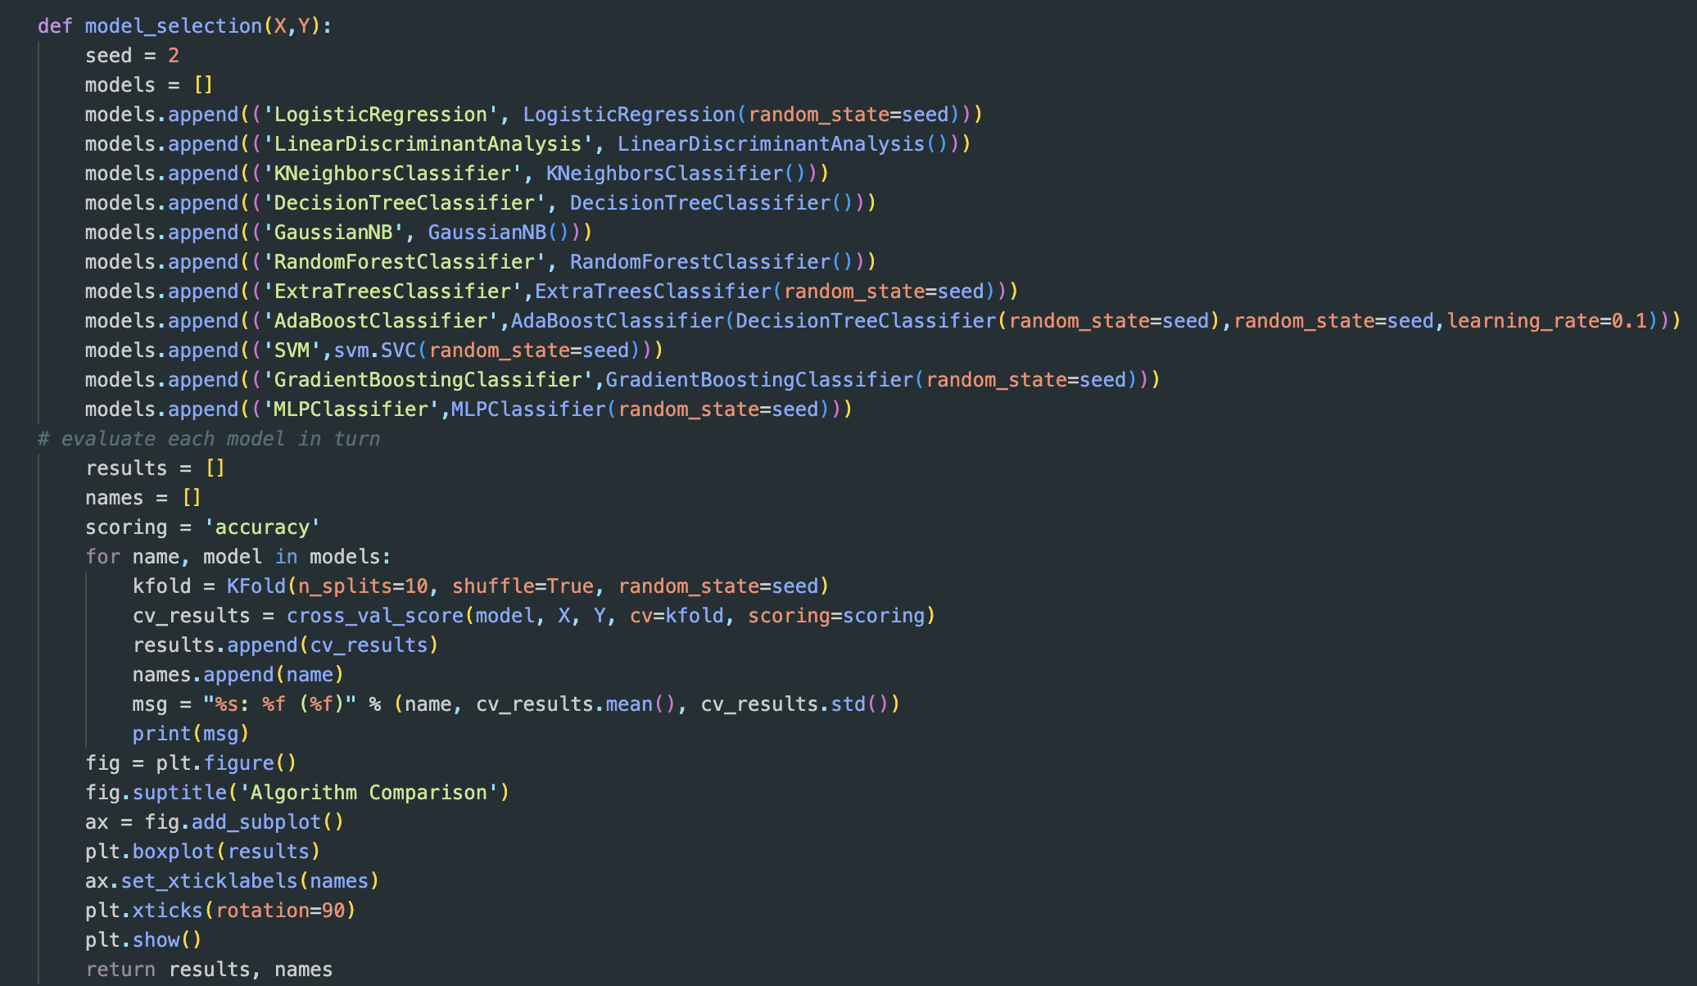
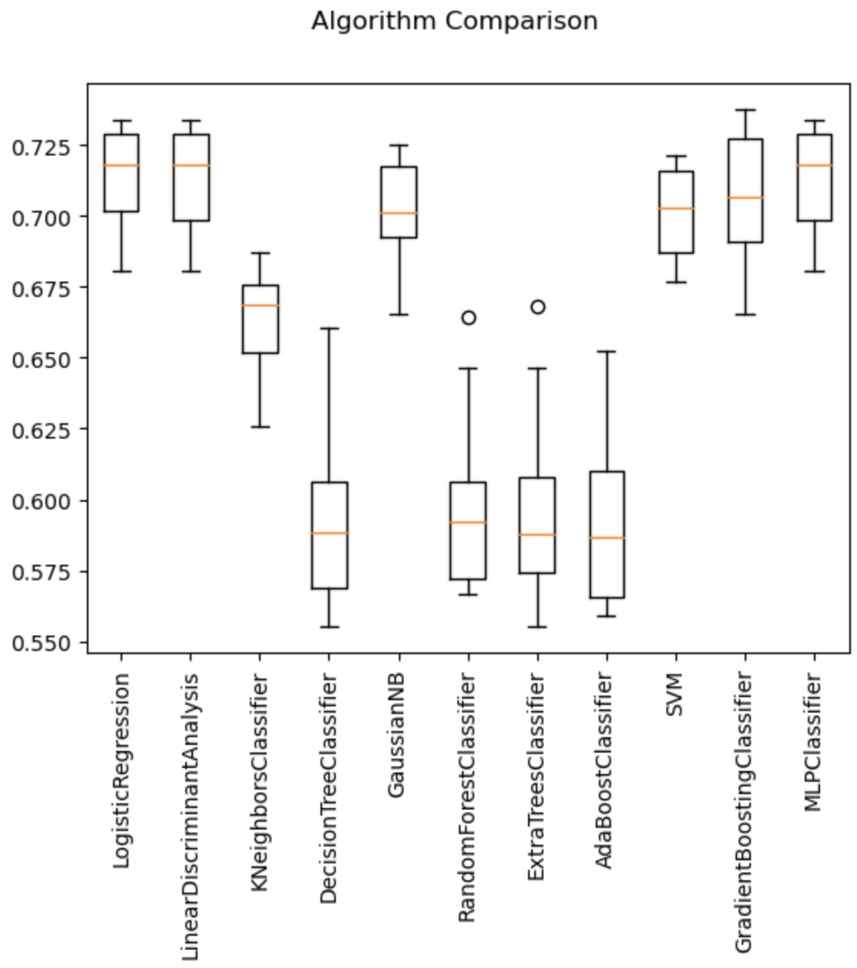
Model Framework
Note: Temp Images

Slide 10
Testing & Evaluating the model's performance

Slide 11
Conclusions

Slide 12
Next Steps

